Slide 1
The Basis for Diseases
Prof. Pushpa Raj Sharma

Slide 2
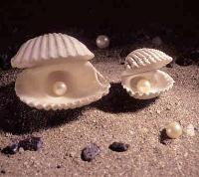
Who am I?
I am not eyes, , kidney or brain.
I see with my eyes, my heart beats, I have new kidney, my brain thinks.
My eyes were removed because of disease, my heart stopped beating and now it beats through pacemaker, my brain have infarct and I can not move my right half.

Slide 3
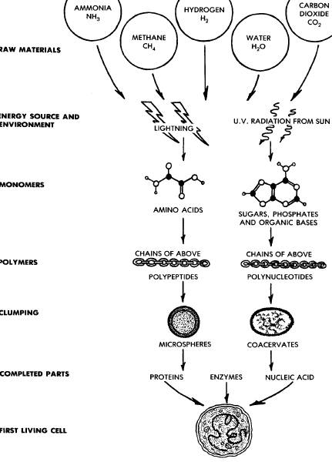
Autobiogenesis:
Spontaneous Origin of Life
Research into 1970’s supportive
Oparin, Haldane, 1930’s

Slide 4
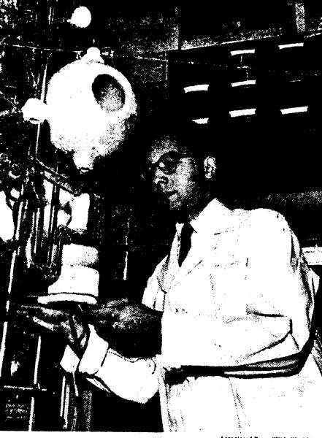
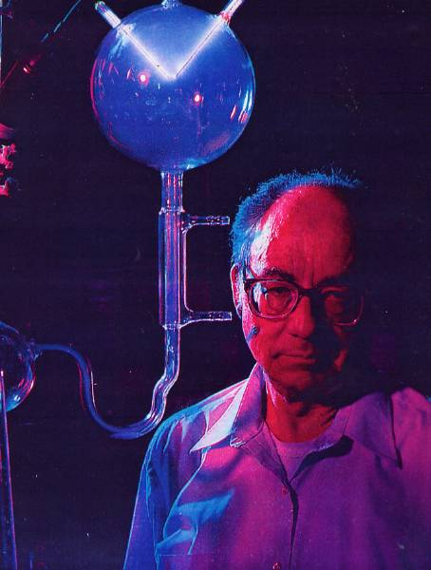
Stanley Miller
the chemical origin of life is a lot more difficult than we first imaged
Father of 'Origin of Life’ Chemistry Dies
May 21, 2007
National Geographic 1998

Slide 5
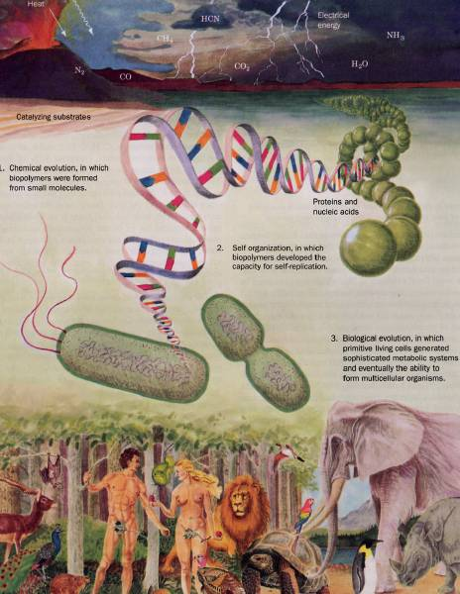
Biochemistry D. Voet & J.G. Voet Wiley 2004

Slide 6
Sharing of programmed physical materials

Slide 7
The biological body

Slide 8
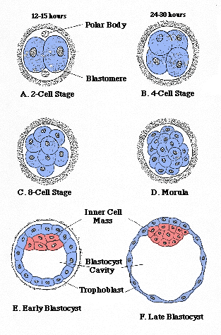
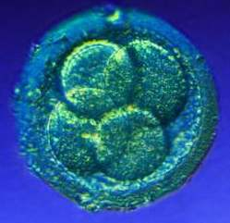
As it divides

Slide 9
Shape does not differ much from monkey or horse

Slide 10
Eight weeks of fetal life

Slide 11
16 weeks of fetal life

Slide 12
20 weeks of fetal life

Slide 13
24 weeks: the first smile

Slide 14
36 weeks: just before birth

Slide 15
The Karma begins

Slide 16
The physical brain and peripheral nervous system matures for function of body

Slide 17
Body = Physical Its origin?
DNA
Programmed
RNA

Slide 18
Physical= Body = Disease Its origin?
External
Environment
Internal

Slide 19
The physical brain for body
The collective conscious and unconscious processes in a sentient organism that direct and influence mental and physical behavior.
The metaphysical MIND

Slide 20
our mind has the ability to make our life satisfying and uplifting or it can make it dull and uninteresting.
We are able, through our mind, to uplift others and to create beauty and harmony around us. The way we think is of paramount importance in our life as our mind has control over our body.
Our mind builds up patterns over time.
This develops our personality

Slide 21
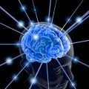
Metaphysical: Mind = Aatma
The ability to think, wish or will : THOUGHT
The ability to judge, understand or investigate: INTELLECT
The ability to retain impressions of past thoughts in the form of attitudes, moods or habits: SANSKAR

Slide 22
Atma needs mature brain to act through Indriyas

Slide 23
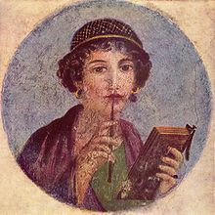
Thought
Thoughts are forms created in the mind, rather than the forms perceived through the five senses. Thought and thinking are the processes by which these imaginary sense perceptions arise and are manipulated.

Slide 24
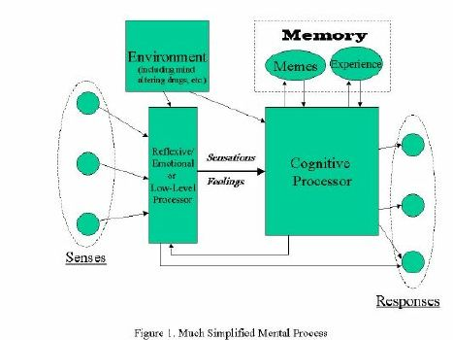
Thinking process

Slide 25
Intellect
This is the faculty of understanding and decision-making that stands out as the most crucial faculty of consciousness.

Slide 26
Sanskara
These are basic patterns that lie within our mind and emotions.

Slide 27
Everyone and everything causes an impression to be formed within our mind and emotions (feelings). This in turn affects our physical form. All are linked. Some events may cause only light impressions, whilst others deep ones.

Slide 28
Walter Bradford Cannon, MA, MD (1871– 1945)
When an animal is strongly aroused, the sympathetic division of its autonomic nervous system combines with the hormone adrenaline to mobilize the animal for an emergency response of “flight or fight.” The “sympathico-adrenal system” orchestrates changes in blood supply, sugar availability, and the blood’s clotting capacity in a marshaling of resources keyed to the “violent display of energy.”
1915 book, Bodily Changes in Pain, Hunger, Fear and Rage.3

Slide 29
Psychoneuroimmunology (PNI)
PNI takes an interdisciplinary approach, incorporating :
psychology, neuroscience, immunology, physiology, pharmacology, molecular biology, psychiatry, behavioral medicine, infectious diseases, endocrinology, and rheumatology.
In 1975 Robert Ader and Nicholas Cohen at the University of Rochester advanced PNI with their demonstration of classic conditioning of immune function, and coined the term "psychoneuroimmunology".
a signal via the nervous system (taste) was affecting immune function.
In 1981 David Felten, then working at the Indiana University of Medicine, discovered a network of nerves leading to blood vessels as well as cells of the immune system
In 1985, research by neuropharmacologist Candace Pert revealed that neuropeptide-specific receptors are present on the cell walls of both the brain and the immune system

Slide 30
Psychoneuroimmunology (PNI)
There is now sufficient data to conclude that immune modulation by psychosocial stressors and/or interventions can lead to actual health changes.
Stressful events trigger cognitive and affective responses which, in turn, induce sympathetic nervous system and endocrine changes, and these ultimately impair immune function:
“all-cause mortality increased in the month following a severe stressor – the death of a spouse.”
Kaprio, J., Koskenvuo, M., and Rita, H. (1987). Mortality after bereavement: a prospective study of 95,647 widowed persons. American Journal of Public Health 77(3), 283-7.

Slide 31
Psychoneuroimmunology (PNI)
Stress is thought to affect immune function through emotional and/or behavioral manifestations such as anxiety, fear, tension, anger and sadness and physiological changes such as heart rate, blood pressure, and sweating.
Herbert and Cohen in 1993:
They found consistent stress-related increases in numbers of total white blood cells, as well as decreases in the numbers of helper T cells, suppressor T cells, and cytotoxic T cells, B cells, and Natural killer cells (NK).
Herbert TB, Cohen S. Stress and immunity in humans: a meta-analytic review. Psychosom Med. 1993;55:364–379

Slide 32
Psychoneuroimmunology (PNI)
Communication between the brain and immune system
Stimulation of brain sites alters immunity (stressed animals have altered immune systems).
Immune cells produce cytokines that act on the CNS.
Immune cells respond to signals from the CNS.
Communication between neuroendocrine and immune system
Glucocorticoids and catecholamines influence immune cells.
Endorphins from pituitary & adrenal medulla act on immune system.
Activity of the immune system is correlated with neurochemical/neuroendocrine activity of brain cells.

Slide 33
Psychoneuroimmunology (PNI)
Connections between glucocorticoids and immune system
Anti-inflammatory hormones that enhance the organisms response to a stressor.
Prevent the overreaction of the body own defense system.
Regulators of the immune system.
Affect cell growth, proliferation & differentiation.
Cause immunosuppression.
Suppress cell adhesion, antigen presentation, chemotaxis & cytotoxicity.
Increase apoptosis
Corticotropin-releasing hormone (CRH)
Release of corticotropin-releasing hormone (CRH) from the hypothalamus is influenced by stress.
CRH is a major regulator of the HPA axis/stress axis.
CRH Regulates secretion of Adrenocorticotropic hormone (ACTH).
CRH is widely distributed in the brain and periphery
CRH also regulates the actions of the Autonomic nervous system ANS and immune system.

Slide 34
Health
Hippocrates, stated something similar over 2,000 years ago - in the 5th century BC:
"Positive health requires knowledge of man's primary constitution and the powers of various foods, both those natural to them and those resulting from human skills. But eating alone is not enough for health. There must be exercise, of which the effects must likewise be known. The combination of these two things makes regimen, when proper attention is given to the seasons of the year, the changes of the winds, the age of the individual and the situation of his home".

Slide 35
Disease: Any deviation from or interruption of the normal structure or function of any body part, organ, or system that is manifested by a characteristic set of symptoms and signs and whose etiology, pathology, and prognosis may be known or unknown. Health: Health is a state of complete physical, mental and social well-being and not merely the absence of disease or infirmity. (1948 WHO) An expansion of the WHO definition may be necessary to include a spiritual dimension of health if social scientists can agree that spirituality is part of health and not merely an influence. James S Larson. The World Health Organization's definition of health: Social versus spiritual health . 1996 Social Indicators Research. Volume 38, Number 2. 181-192,

Slide 36
Burn Out Syndrome: 1970
Burnout has been described by Maslach and coworkers:
As a condition in which professionals “lose all concern, all emotional
feeling for the people they work with, and come to treat them
in a detached or even dehumanized way.”
Professional burnout is a psychological syndrome arising in response to chronic interpersonal stressors on the job .
Burnout is a problem that is specific to the work context, in contrast to depression, which tends to pervade every domain of a person’s life .
Physical illness, emotional problems, increased turnover, absenteeism
and poor job performance and negative attitudes in general .

Slide 37
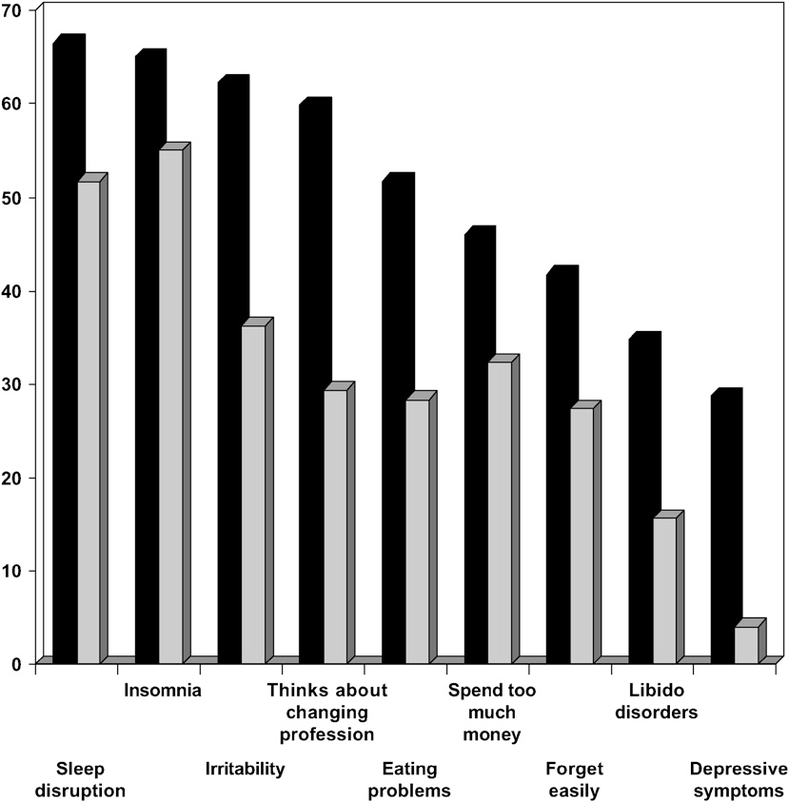
Burn Out Syndrome

Slide 38
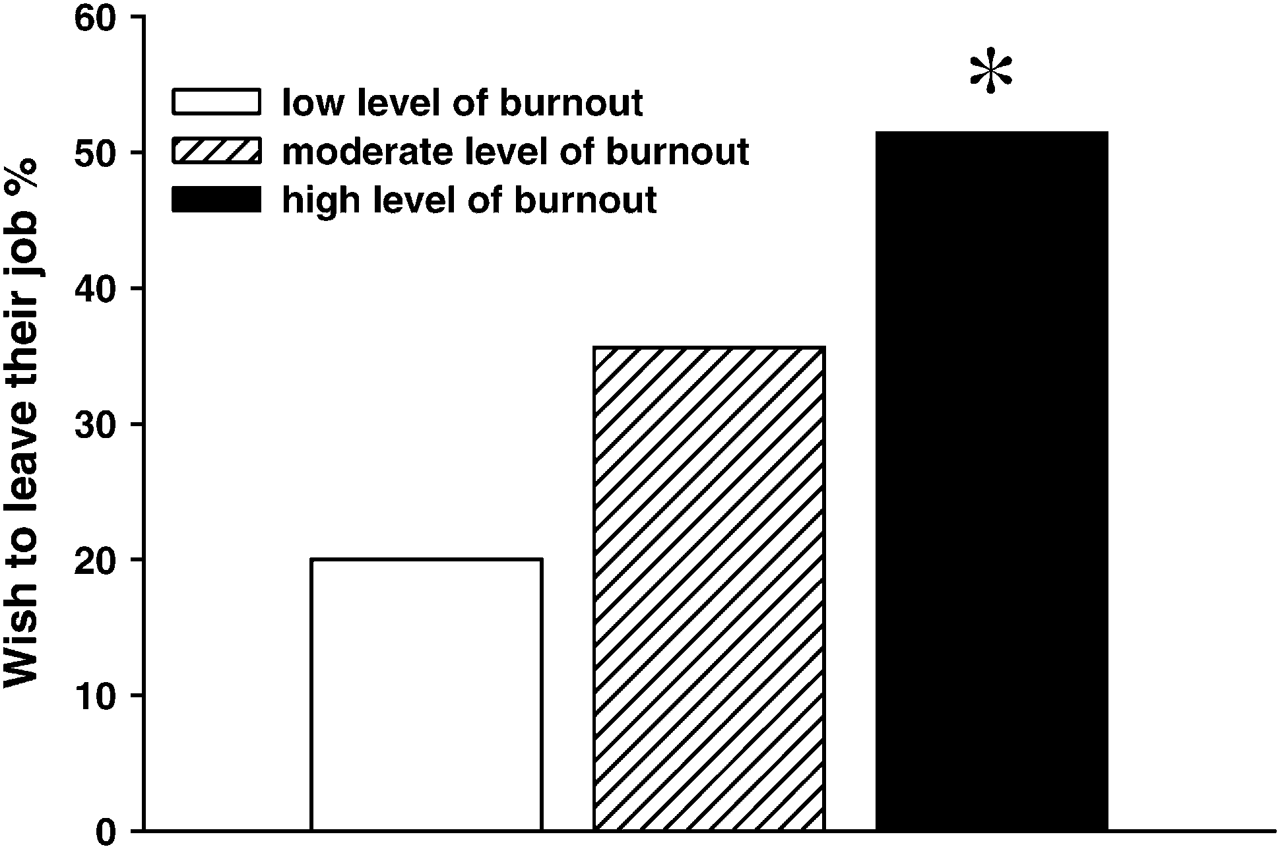
Burn Out Syndrome

Slide 39
Monday, October 11, 2010 NY Times
For several decades now, studies have consistently shown that physicians have higher rates of suicide than the general population — 40 percent higher for male doctors and a staggering 130 percent higher for female doctors.
Students enter medical school with mental health profiles similar to those of their peers but end up experiencing depression, burnout and other mental illnesses at higher rates.

Slide 40
Medical Council Examination
“Survival of the fittest” mentality can affect all medical students, not just those who are depressed or burned out. And it can affect patients by wearing away at a young doctor’s sense of empathy.

Slide 41
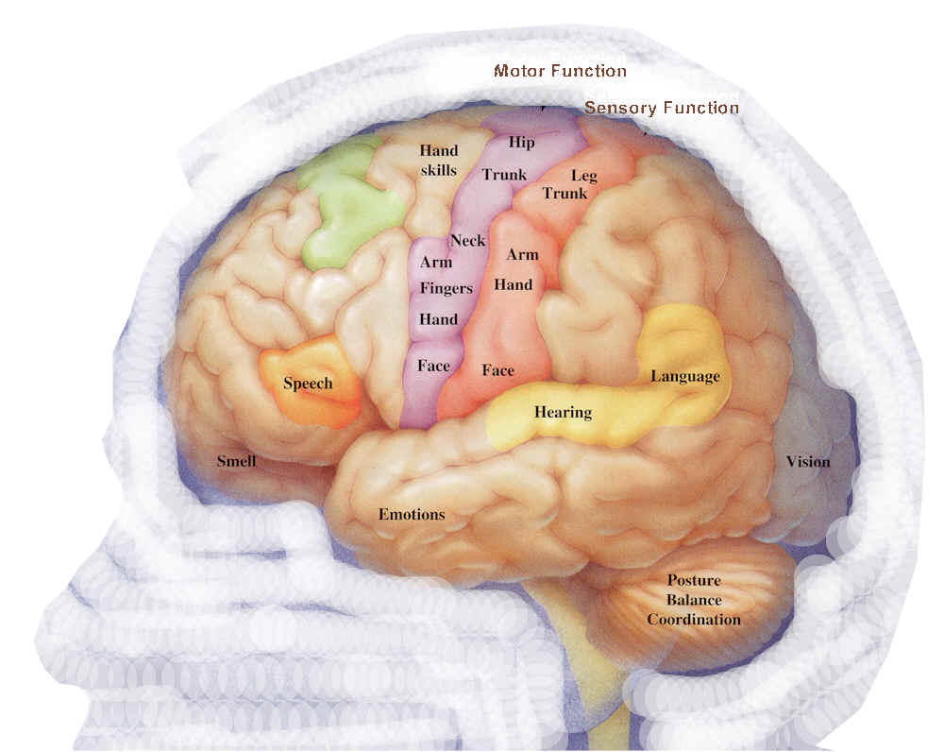
Two Consciousness
Sensory organs reacts with nature
Has the innate qualities of positivity

Slide 42
Dr. Masaru Emoto's The True Power of Water: hypothesis: "Water shows different shapes of ice crystals depending on the information it has received."
Interestingly, water responded to foreign words in a similar but not exact manner as it did to Japanese words.
Water formed beautiful crystals to all the words expressing gratitude all over the world, such as
thank you (English), duoxie (Chinese), merci (French), danke (German), grazie (Italian), and kamusamunida (Korean).

Slide 43
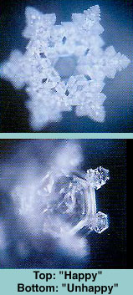
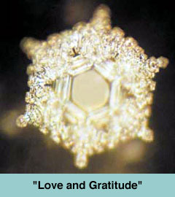
Dr. Masaru Emoto's The True Power of Water: hypothesis: "Water shows different shapes of ice crystals depending on the information it has received."
"We must pay respect to water and feel love and gratitude, and receive
vibrations with a positive attitude. Then, water changes, you change,
and I change. Because both you and I are water." (From the book cover.)
The Hidden Messages in Water, and his books have been published in 24 languages

Slide 44
Within each human being there is a higher aspect and this is our soul. The soul is beyond the human personality that has incarnated this time around. The soul is the powerhouse and without it, we would not be. It holds the blueprint or plan for this lifetime. We are meant to be in touch with our soul to receive help and guidance with our daily life. Connecting to our soul is vitally important.

Slide 45
Consciousness
Soul consciousness
Body consciousness
Desire for experiences that provide:
Love
Peace
Happiness
Truth
Purity
Desire for experiences that provide:
Fulfilling expectations
Attachment
Ego
Money
Materials
Position

Slide 46
Atma: Point of light that destroys darkness
Point of light
Purity
Peace
Love
Fearlessness
Positive energy
Bliss

Slide 47
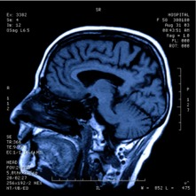
The Amazing Gland
Endorphins
Pituitary Gland
Analgesia
Happiness
Immune response enhancement

Slide 48
Endorphins
1960s,
"opiate receptors" in brain tissue.
biochemicals that might be synthesized in the brain itself.
1970s
several small peptides were isolated that apeared to possess natural analgesic properties, and these were collectively termed enkephalins and endorphins
Terenius, 1982
Endorphins are the body's own opiate.
Notes:
The discovery of this class of biochemicals has an unusual and interesting history. In the 1960s, biomedical researchers studying the causes and effects of opium addiction had detected what they suspected were "opiate receptors" in brain tissue. Since it seemed quite unlikely that humans (or other vertebrates) would contain a specific receptor designed for a chemical derived from the poppy plant, the researchers focused their attention on biochemicals that might be synthesized in the brain itself. Early in the 1970s, several small peptides were isolated that appeared to possess natural analgesic properties, and these were collectively termed enkephalins and endorphins

Slide 49
Endorphins
Andersson and Lundeberg, 1995
They are important for pain control, as well as regulating blood pressure and body temperature). During stress, people who secrete endorphins have lower heart rate reactivity.
McCabe, et al., 1992
Before and during recovery from stress, an endorphin producer has lower mean arterial blood pressure.
Cornejo, 1995; Davis, 1984
Endorphins are hundreds of times more powerful than heroin and many times more than morphine In terms of stimulant power, they have a tremendous impact on attitude, the will and mental insight
Great leaders produce high levels of endorphins (Cornejo, 1995). From a physiological viewpoint, this helps explain their energy, tenacity and power despite the problems they face. For instance, how did a person like Mother Teresa, so small and frail, work so hard and feed thousands of people each day?
Notes:
The Importance of Endorphins
Endorphins are substances produced only by the human brain. They are important for pain control, as well as regulating blood pressure and body temperature (Andersson and Lundeberg, 1995). During stress, people who secrete endorphins have lower heart rate reactivity. Before and during recovery from stress, an endorphin producer has lower mean arterial blood pressure (McCubbin, et al., 1992). Endorphins are the body's own opiate (Terenius, 1982).
Endorphins are hundreds of times more powerful than heroin and many times more than morphine (Cornejo, 1995; Davis, 1984). In terms of stimulant power, they have a tremendous impact on attitude, the will and mental insight. Experimental work with animals has shown improvements in memory and learning capacity when endorphins were involved (Davis, 1984).
Great leaders produce high levels of endorphins (Cornejo, 1995). From a physiological viewpoint, this helps explain their energy, tenacity and power despite the problems they face. For instance, how did a person like Mother Teresa, so small and frail, work so hard and feed thousands of people each day?
Endorphins make us feel good. They give us a sensation of wellness and peace, helping shrink our problems to their true dimensions. They diminish our giants, creating a euphoric effect that gives us energy, enthusiasm and power to accomplish daily tasks (Pierce, et al., 1993).
Since endorphins are so important, what can we do to produce them? Several stimuli make our brains produce these substances, such as meditation, laughing and positive attitude (Harte, Eifert and Smith, 1995). There is one stimulus, however, that makes our brains produce endorphins in larger amounts-intensive aerobic exercise (Rahkila, et al, 1988

Slide 50
Endorphins
There is one stimulus, however, that makes our brains produce endorphins in larger amounts-intensive aerobic exercise (Rahkila, et al, 1988).
Endorphins make us feel good. They give us a sensation of wellness and peace, helping shrink our problems to their true dimensions. They diminish our giants, creating a euphoric effect that gives us energy, enthusiasm and power to accomplish daily tasks (Pierce, et al., 1993).
Since endorphins are so important, what can we do to produce them? Several stimuli make our brains produce these substances, such as meditation, laughing and positive attitude (Harte, Eifert and Smith, 1995).

Slide 51
in the 1970s when a book written by Norman Cousins was published, which related his use of Marx Brothers films and humorous stories to help alleviate pain he had been suffering from ankylosing spondylitis.
in 1989 when the Journal of the American Medical Association published an article by Swedish scientist Lars Ljungdahl entitled "Laugh If This Is a Joke," which argued that "a humor therapy program can increase the quality of life for patients with chronic problems" and "laughter has an immediate symptom-relieving effect for these patients, an effect that is potentiated when laughter is induced regularly over a period."

Slide 52
Four distinct groups of endorphins have been identified to date. They have been termed: alpha-endorphin, a polypeptide with 16 residues; beta-endorphin, a polypeptide with 31 residues; gamma-endorphin, a polypeptide with 17 residues; and sigma-endorphin, a polypeptide with 27 residues.
The most interesting example of this is the pituitary multihormone precursor termed pro-opiomelanocortin that contains the sequences for beta-lipotropin, melanocyte-stimulating hormone (MSH), endorphins, enkephalins, and adrenocorticotropic hormone (ACTH). After synthesis, this peptide is cleaved in the pituitary to generate ACTH and beta-lipotropin, while processing in the central nervous system produces endorphins and enkephalins, along with some other products.

Slide 53
The Bliss in meditation
Endorphins are among the brain chemicals known as neurotransmitters, which function to transmit electrical signals within the nervous system. At least 20 types of endorphins have been demonstrated in humans. Endorphins can be found in the pituitary gland, in other parts of the brain, or distributed throughout the nervous system.
Stress and pain are the two most common factors leading to the release of endorphins. Endorphins interact with the opiate receptors in the brain to reduce our perception of pain and act similarly to drugs such as morphine and codeine. In contrast to the opiate drugs, however, activation of the opiate receptors by the body's endorphins does not lead to addiction or dependence.
In addition to decreased feelings of pain, secretion of endorphins leads to feelings of euphoria, modulation of appetite, release of sex hormones, and enhancement of the immune response. With high endorphin levels, we feel less pain and fewer negative effects of stress. Endorphins have been suggested as modulators of the so-called "runner's high" that athletes achieve with prolonged exercise. While the role of endorphins and other compounds as potential triggers of this euphoric response has been debated extensively by doctors and scientists, it is at least known that the body does produce endorphins in response to prolonged, continuous exercise.
Notes:
Endorphins are among the brain chemicals known as neurotransmitters, which function to transmit electrical signals within the nervous system. At least 20 types of endorphins have been demonstrated in humans. Endorphins can be found in the pituitary gland, in other parts of the brain, or distributed throughout the nervous system.
Stress and pain are the two most common factors leading to the release of endorphins. Endorphins interact with the opiate receptors in the brain to reduce our perception of pain and act similarly to drugs such as morphine and codeine. In contrast to the opiate drugs, however, activation of the opiate receptors by the body's endorphins does not lead to addiction or dependence.
In addition to decreased feelings of pain, secretion of endorphins leads to feelings of euphoria, modulation of appetite, release of sex hormones, and enhancement of the immune response. With high endorphin levels, we feel less pain and fewer negative effects of stress. Endorphins have been suggested as modulators of the so-called "runner's high" that athletes achieve with prolonged exercise. While the role of endorphins and other compounds as potential triggers of this euphoric response has been debated extensively by doctors and scientists, it is at least known that the body does produce endorphins in response to prolonged, continuous exercise.

Slide 54
The colour of universe

Slide 55
Every birth can survive for 90 years
Scandavian Countries

Slide 56
We can survive
Notes:
The bottom panel depicts the same distributions conditional on survival to age 10, an age that is arbitrary but convenient (Edwards and Tuljapurkar 2005). Here, once we have removed the impact of infant mortality, we can see a nearly perfect rightward shift of the adult length of life distribution, resulting in a higher mean adult life expectancy with very little, if any, change in total variance. This dynamic is all but impossible to see or measure in the top panel because trends in infant mortality tend to overwhelm measures of total inequality.

Slide 57
Swiss Age

Slide 58
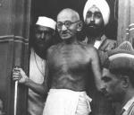
Power based on love is a thousand times more effective and permanent then the one derived from fear of punishment. — Mahatma Gandhi

Slide 59
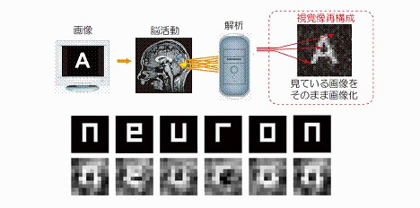
Thoughts
The scientists were able to reconstruct various images viewed by a person by analyzing changes in their cerebral blood flow. Using a functional magnetic resonance imaging (fMRI) machine, the researchers first mapped the blood flow changes that occurred in the cerebral visual cortex as subjects viewed various images held in front of their eyes.
Then, when the test subjects were shown a completely new set of images, such as the letters N-E-U-R-O-N, the system was able to reconstruct and display what the test subjects were viewing based solely on their brain activity.

Slide 60
The Yoga that gives us bliss
Easy to perform
Can be done any time
Cane be performed any place.
Has adhyatmic basis
Has scientific basis
Practiced for many years
Place that teaches freely
Availability to learn easily.

Slide 61
The Effect of Raj Yoga
Leads to enhancement of parasympathetic activities.
Secretion of more endorphins.
Controls essential hypertension.
Reversal of coronary arterial blockage.
Provides stability of autonomic balance during stress.
Produces immunomodulation for infections.
Produces hormonal balance.
Produces a relative hypermetabolic state, reduces obesity.
Improves thermoregulation efficiency.
Improves body flexibility.
Physical efficiency at sub maximal level of work.
Improves adaptability to environmental stress and cognitive function such as concentration, memory, learning efficiency and vigilance.

Slide 62
What you want? Bliss or Misery; Atma conscious or Body conscious.
It is your choice.

Slide 63
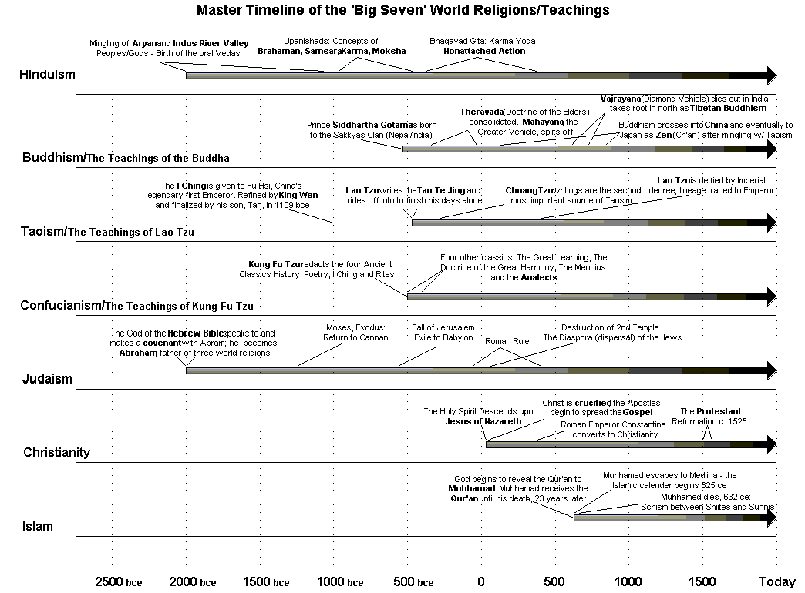

Slide 64
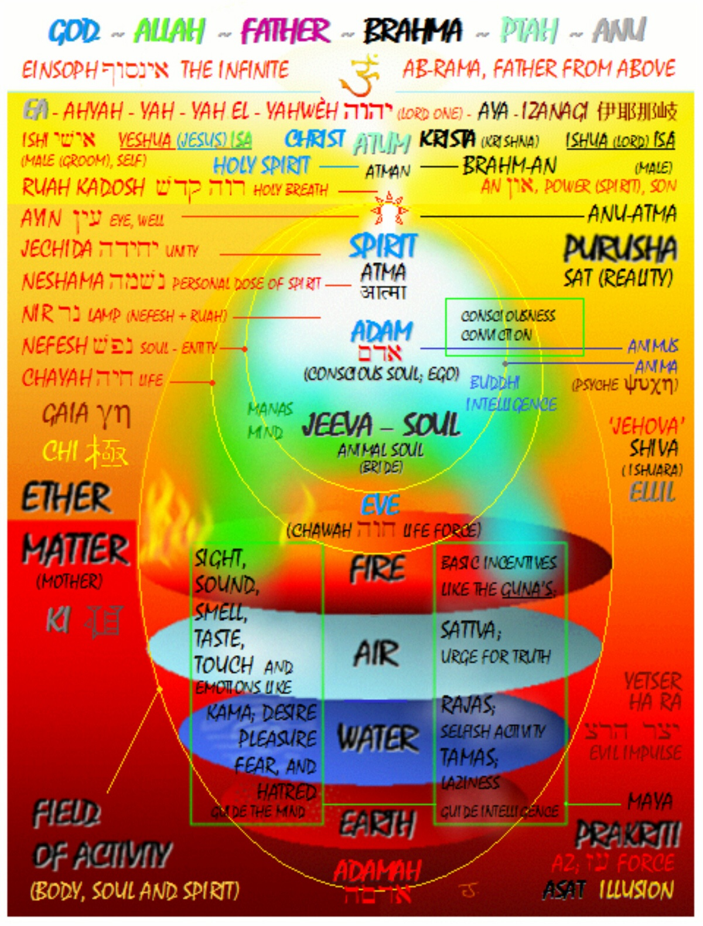

Slide 65
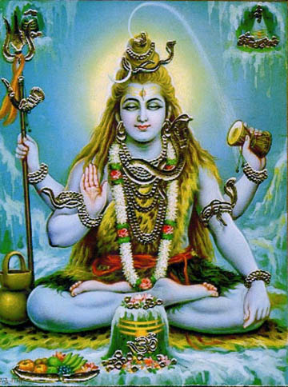
YOU ARE THE THOUGHT OF A THOUGHT THE WITNESS TO ALL THOUGHTS THE SOURCE OF ALL THOUGHTS THE RISING AND SETTING OF ALL THOUGHTS AND THAT WHICH CAUSES THOUGHT TO EMERGE

Slide 66
Mundeshwari: Oldest functional temple in India
From its stone inscriptions it is evident that the temple was present in 600 AD.
It is 22 kilometres from the GT Road that links Varanasi to Gaya.
In the middle of the temple There is a two feet high Shiva linga.

Slide 67
The Brahma Kumari Way
Looking Yourself with Atma

Slide 68
Paramatma
The ocean of peace
The ocean of love
The ocean of happiness
The ocean of truth
The ocean of purity

Slide 69
Part of Paramatma
Param Atma
Shape less
Colour less
Character less
Can not be felt by sense organs
No gender
Always positive
Atma ---- I am

Slide 70
I =Atma= Sat-Chit-Ananda
Love
Peace
Happiness
Truth
Purity

Slide 71
Karmendeya badhika raste ma falesu kadachana
I have to do right karma.
I should not expect its fruits.
It is my dharma
It should not be under the influence of:
Hatred - Greed
Anger - Ego
Lies - Partiality
Prejudice - Lust

Slide 72
Physical= Body Mental = Mind
Mind
Thoughts
Intellect
Sanskars

Slide 73
Habituation is a decrease in response to a stimulus after repeated presentations.
We think normal to stimulus
around us and we do not react
to it.
We have not felt Atma the
Ultimate Sat-chit-Anand and
we are habituated with
the outer world.

Slide 74
Thank you

Slide 75
Physical and Mental
Body
Physical
Mental
- Of or relating to the mind; intellectual: mental powers.
-Executed or performed by the mind; existing in the mind: mental images of happy times.
-Of, relating to, or affected by a disorder of the mind.
-Intended for treatment of people affected with disorders of the mind.
-Of or relating to telepathy or mind reading

Slide 76
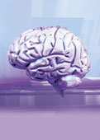
Brain: Metaphysical part
The ability to think, wish or will: MIND
The ability to judge, understand or investigate: INTELLECT
The ability to retain impressions of past thoughts in the form of attitudes, moods or habits: SANSKARS

Slide 77
Mind
The collective conscious and unconscious processes in a sentient organism that direct and influence mental and physical behavior.

Slide 78
Brain
The ability to think, wish or will: MIND
The ability to judge, understand or investigate: INTELLECT
The ability to retain impressions of past thoughts in the form of attitudes, moods or habits: SANSKARS

Slide 79
Thoughts: Process for emotions, desires, and sensations

Slide 80
Sansakars
It takes the form of habits, talents, emotional temperaments, personality traits, beliefs, values or instincts.
It is shaped by memory, physical and biological environment, and gene .

Slide 81
Sanskars
Personality
Habituations
Tendencies
Memory
Subconscious processing

Slide 82
A relatively stable and characteristic of the general way of being and act of a person in its response to situations in which it is Personality. Tendencies show the consistent pattern of cognition, affect and behavior of individuals.

Slide 83
The physical brain for body
The collective conscious and unconscious processes in a sentient organism that direct and influence mental and physical behavior.
MIND

