Slide 1
Metaphysical Health
Prof. Pushpa Raj Sharma

Slide 2
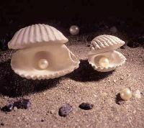
The first question…………………..
Who am I?

Slide 3
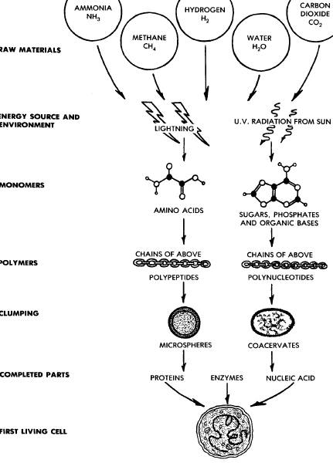
The Journey……………….
Oparin, Haldane,
1930’s
Research into 1970’s supportive

Slide 4
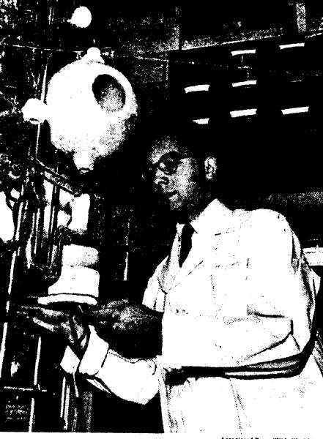
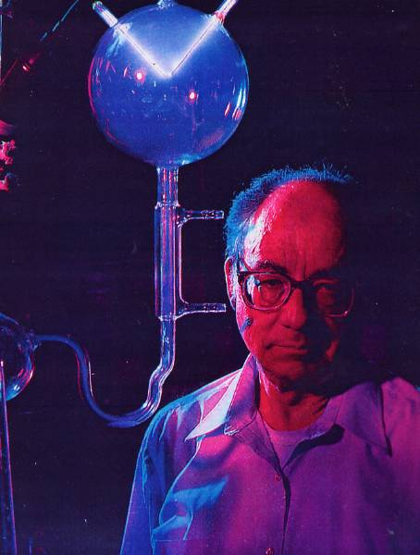
Stanley Miller
the chemical origin of life is a lot more difficult than we first imaged
Father of 'Origin of Life’ Chemistry Dies
May 21, 2007
National Geographic 1998

Slide 5
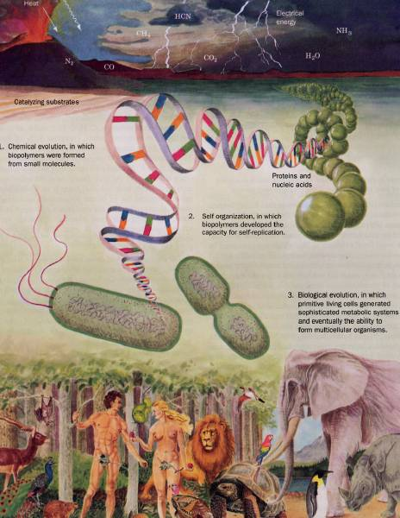
Biochemistry D. Voet & J.G. Voet Wiley 2004

Slide 6
Amoeba movement

Slide 7
Who am I?
My body is created by these Pancha Mahabhut

Slide 8
Video spermetozoa fertilizing ovum

Slide 9
Physical= Body = Disease Its origin?
External
Environment
Internal

Slide 10
The physical brain for body has other dimension…………
The collective conscious and unconscious processes in a sentient organism that direct and influence mental and physical behavior.
The metaphysical MIND

Slide 11
Development of body consciousness
Cosmos (Metaphysical
Universe (Physical)
Earth (Physical)
Life (Physical)
Human Cells
Body Development
Reacts with Earth
Survival reflexes, growth of desire, anger, fear, ego
Body consciousness

Slide 12
Metaphysics
Metaphysics is a branch of philosophy concerned with explaining the
fundamental nature of being and the world.
Ontology: The study of Being and existence; includes the definition and classification of entities, physical or mental, the nature of their properties, and the nature of change.
Natural Theology: The study of a Gods; involves many topics, including among others the nature of religion and the world, existence of the deivine, questions about Creation, and the numerous religious or spiritula issues that concern humankind in general.
Universal Science :The study of first principles, which Aristotle believed were the foundation of all other inquiries. An example of such a principle is the law of noncontradiction and the status it holds in non-paraconsistent logics.

Slide 13
HUMAN BEING
HUMUS
C O N S C I O U S N E S S
BEING
SOIL
SOUL
STABILITY, LOVE, PEACE, POSITIVE ENERGY
FEAR, ANGER, ATTACHMENT, NEGATIVE ENERGY

Slide 14
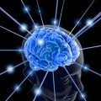
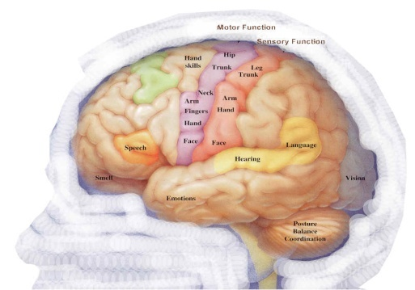
Consciousness
Soul consciousness
Body consciousness
Desire for experiences that provide:
Love
Peace
Happiness
Truth
Purity
Desire for experiences that provide:
Fulfilling expectations
Attachment
Ego
Money
Materials
Position

Slide 15
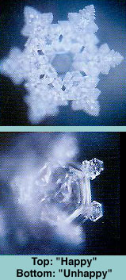
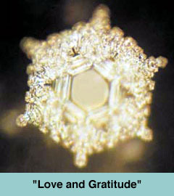
Dr. Masaru Emoto's The True Power of Water: hypothesis: "Water shows different shapes of ice crystals depending on the information it has received."
"We must pay respect to water and feel love and gratitude, and receive
vibrations with a positive attitude. Then, water changes, you change,
and I change. Because both you and I are water." (From the book cover.)
The Hidden Messages in Water, and his books have been published in 24 languages

Slide 16
Types of person
Hippocrates. This Greek physician classified or typed people using a system of four elements – air, earth, water and fire. He described people who had excessive amounts of each of these as sanguine, melancholic, phlegmatic or choleric
Ayurveda. This is also an ancient and very complex system of healing that classifies people as pitta, vatta and kapha, and combinations of these three doshas, as they are called.

Slide 17
“Reduction in negative effect, tiredness, and aches and pains and increase in emotion regulation, feeling of calmness, eand self acceptance”
BroedrickPC, Metz S. Learning to BREATHE: a pilot trial of mindfulness curriculum for adolescents. Adv School Mental Health Promot. 2009;2:35-46.
“Significant decrease in systolic and diastolic blood pressures as well as blood pressure reactivity to a social stresser interview”
Barnes VA, Davis HC, Murzynowski JB, Treiber FA. Impact of meditation on resting and ambulatory blood pressure and heart rate in youth. Psychosom Med. 2004;66:909-904.

Slide 18
Autonomic types. Dr. Melvin Page, DDS and others, perhaps, such as William Kelley, DDS, type people by which branch of the autonomic nervous system is dominant – sympathetic or parasympathetic types.
Personality type A or Type B
Fast and slow oxidizers based on blood pH and CO2 levels (Dr. George Watson ). The blood of fast oxidizers tended to be slightly more acidic. He also identified another metabolic type he called sub-oxidizers. This was a group of people that did not quite fit into the fast or slow oxidizer category.

Slide 19
Fast Oxidation = an Alarm Stage of Stress = a Sympathetic State of body chemistry. For example, he asserted that an alarm stage of stress (the fight-or-flight response) is a sympathetic state. It also tends to correspond to a fast oxidizer. This is not too hard to understand. All are characterized by excessive activity of the thyroid and adrenal glands and a hyper-alert state of the nervous system.

Slide 20
Slow Oxidation = Resistance or Exhaustion Stage of Stress = a more Parasympathetic state of body chemistry. As stress continues, the thyroid and adrenal glands begin to “burn out” and one goes into the resistance and exhaustion stages of stress. The oxidation rate begins to slow and the body begins to move from a sympathetic to an unhealthy parasympathetic state. The latter occurs not because one chooses it, but because the sympathetic system becomes depleted of nutrients and can no longer function correctly. As a result, the body flips into a parasympathetic state, in part to prevent further catabolism and breakdown of the body.

Slide 21
Healthy parasympathetic dominant individuals: They love to relax, do not react to stress and may rest all day, not because they are tired but because they are content.
Sympathetic dominant individuals: They include compulsiveness, running around excessively, overworking, excessive thinking, fearfulness, anxiety, worry or anger. One may talk, think and work fast.

Slide 22
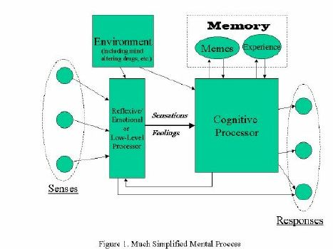
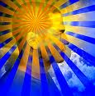
Thinking Process
Environment
Memes
Experience
Reflexive/ or low level processosr
Cognitive Processor
Senses
Responses
Simplified Process of Thinking

Slide 23
Upper and lower metaphysical neurology
Atma Conscious
ATMA
Body Conscious
INTELLECT
MIND
Sensory Organs
ACTIONS
ACTIONS

Slide 24
Ivan Pavlov’s experiment (1927)

Slide 25
Walter Bradford Cannon, MA, MD (1871– 1945)
When an animal is strongly aroused, the sympathetic division of its autonomic nervous system combines with the hormone adrenaline to mobilize the animal for an emergency response of “flight or fight.” The “sympathico-adrenal system” orchestrates changes in blood supply, sugar availability, and the blood’s clotting capacity in a marshaling of resources keyed to the “violent display of energy.”
1915 book, Bodily Changes in Pain, Hunger, Fear and Rage.3

Slide 26
Psychoneuroimmunology (PNI)
In 1975 Robert Ader and Nicholas Cohen at the University of Rochester advanced PNI with their demonstration of classic conditioning of immune function, and coined the term "psychoneuroimmunology". A signal via the nervous system (taste) was affecting immune function.
In 1981 David Felten, then working at the Indiana University of Medicine, discovered a network of nerves leading to blood vessels as well as cells of the immune system.
In 1985, research by neuropharmacologist Candace Pert revealed that neuropeptide-specific receptors are present on the cell walls of both the brain and the immune system.
Notes:
PNI takes an interdisciplinary approach, incorporating :
psychology, neuroscience, immunology, physiology, pharmacology, molecular biology, psychiatry, behavioral medicine, infectious diseases, endocrinology, and rheumatology.
There is now sufficient data to conclude that immune modulation by psychosocial stressors and/or interventions can lead to actual health changes.
Stressful events trigger cognitive and affective responses which, in turn, induce sympathetic nervous system and endocrine changes, and these ultimately impair immune function:
“all-cause mortality increased in the month following a severe stressor – the death of a spouse.”
Kaprio, J., Koskenvuo, M., and Rita, H. (1987). Mortality after bereavement: a prospective study of 95,647 widowed persons. American Journal of Public Health 77(3), 283-7.

Slide 27
Psychoneuroimmunology (PNI)
Herbert and Cohen in 1993:
They found consistent stress-related increases in numbers of total white blood cells, as well as decreases in the numbers of helper T cells, suppressor T cells, and cytotoxic T cells, B cells, and Natural killer cells (NK).
Herbert TB, Cohen S. Stress and immunity in humans: a meta-analytic review. Psychosom Med. 1993;55:364–379
Notes:
Stress is thought to affect immune function through emotional and/or behavioral manifestations such as anxiety, fear, tension, anger and sadness and physiological changes such as heart rate, blood pressure, and sweating.
Communication between the brain and immune system
Stimulation of brain sites alters immunity (stressed animals have altered immune systems).
Immune cells produce cytokines that act on the CNS.
Immune cells respond to signals from the CNS.
Communication between neuroendocrine and immune system
Glucocorticoids and catecholamines influence immune cells.
Endorphins from pituitary & adrenal medulla act on immune system.
Activity of the immune system is correlated with neurochemical/neuroendocrine activity of brain cells.
Connections between glucocorticoids and immune system
Anti-inflammatory hormones that enhance the organisms response to a stressor.
Prevent the overreaction of the body own defense system.
Regulators of the immune system.
Affect cell growth, proliferation & differentiation.
Cause immunosuppression.
Suppress cell adhesion, antigen presentation, chemotaxis & cytotoxicity.
Increase apoptosis
Corticotropin-releasing hormone (CRH)
Release of corticotropin-releasing hormone (CRH) from the hypothalamus is influenced by stress.
CRH is a major regulator of the HPA axis/stress axis.
CRH Regulates secretion of Adrenocorticotropic hormone (ACTH).
CRH is widely distributed in the brain and periphery
CRH also regulates the actions of the Autonomic nervous system ANS and immune system.

Slide 28
MIND: Thoughts, Emotions, Attitudes, Memories
Hypothalamus
Neuronal synapses
Neuropeptides
Cells
Stress Hormones
Endorphins, Enkephalins
Sympathetic dominance
Parasympathetic dominance
Fight or Flight, Sadness, Lack of energy
Feeling of wellbeing, Happiness, Pooling of energy

Slide 29
Endorphins
1960s,
"opiate receptors" in brain tissue.
biochemicals that might be synthesized in the brain itself.
1970s
several small peptides were isolated that apeared to possess natural analgesic properties, and these were collectively termed enkephalins and endorphins
Terenius, 1982
Endorphins are the body's own opiate.
Notes:
The discovery of this class of biochemicals has an unusual and interesting history. In the 1960s, biomedical researchers studying the causes and effects of opium addiction had detected what they suspected were "opiate receptors" in brain tissue. Since it seemed quite unlikely that humans (or other vertebrates) would contain a specific receptor designed for a chemical derived from the poppy plant, the researchers focused their attention on biochemicals that might be synthesized in the brain itself. Early in the 1970s, several small peptides were isolated that appeared to possess natural analgesic properties, and these were collectively termed enkephalins and endorphins.
Andersson and Lundeberg, 1995
They are important for pain control, as well as regulating blood pressure and body temperature). During stress, people who secrete endorphins have lower heart rate reactivity.
McCabe, et al., 1992
Before and during recovery from stress, an endorphin producer has lower mean arterial blood pressure.
Cornejo, 1995; Davis, 1984
Endorphins are hundreds of times more powerful than heroin and many times more than morphine In terms of stimulant power, they have a tremendous impact on attitude, the will and mental insight
Great leaders produce high levels of endorphins (Cornejo, 1995). From a physiological viewpoint, this helps explain their energy, tenacity and power despite the problems they face. For instance, how did a person like Mother Teresa, so small and frail, work so hard and feed thousands of people each day?

Slide 30
Endorphins
There is one stimulus, however, that makes our brains produce endorphins in larger amounts-intensive aerobic exercise (Rahkila, et al, 1988).
Endorphins make us feel good. They give us a sensation of wellness and peace, helping shrink our problems to their true dimensions. They diminish our giants, creating a euphoric effect that gives us energy, enthusiasm and power to accomplish daily tasks (Pierce, et al., 1993).
Since endorphins are so important, what can we do to produce them? Several stimuli make our brains produce these substances, such as meditation, laughing and positive attitude (Harte, Eifert and Smith, 1995).
Notes:
in the 1970s when a book written by Norman Cousins was published, which related his use of Marx Brothers films and humorous stories to help alleviate pain he had been suffering from ankylosing spondylitis.
in 1989 when the Journal of the American Medical Association published an article by Swedish scientist Lars Ljungdahl entitled "Laugh If This Is a Joke," which argued that "a humor therapy program can increase the quality of life for patients with chronic problems" and "laughter has an immediate symptom-relieving effect for these patients, an effect that is potentiated when laughter is induced regularly over a period."
Four distinct groups of endorphins have been identified to date. They have been termed: alpha-endorphin, a polypeptide with 16 residues; beta-endorphin, a polypeptide with 31 residues; gamma-endorphin, a polypeptide with 17 residues; and sigma-endorphin, a polypeptide with 27 residues.
The most interesting example of this is the pituitary multihormone precursor termed pro-opiomelanocortin that contains the sequences for beta-lipotropin, melanocyte-stimulating hormone (MSH), endorphins, enkephalins, and adrenocorticotropic hormone (ACTH). After synthesis, this peptide is cleaved in the pituitary to generate ACTH and beta-lipotropin, while processing in the central nervous system produces endorphins and enkephalins, along with some other products.

Slide 31
BMJ 2011;342:c7086:10.1136/bmj.c7086

Slide 32
Development of Aatma consciousness
Cosmos (Metaphysical
Universe (Physical)
Earth (Physical)
Life (Physical)
Human Cells
Body Development
Reacts with Earth
Survival reflexes, growth of desire, anger, fear, ego
Body consciousness

Slide 33
Meditation
The word meditate stems from the Latin root meditatum, i.e. to ponder.
dhyāna in Buddhism and in Hinduism, which comes from the Sanskrit root dhyai, meaning to contemplate or meditate.
prehistoric times older civilizations used repetitive, rhythmic chants and offerings to appease the gods.
Some of the earliest written records of meditation date to 1500BC in Hindu Vedantism.
Lekhraj started holding satsangs which attracted many people and the group became known as Om Mandali: Hyderabad, Sindh in the 1930s
The Transcendental Meditation or TM technique is a form of mantra meditation introduced in India in 1955 Maharishi Maharishi Mahesh Yogi.

Slide 34
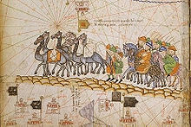
The Silk Road of transmission of Buddhism introduced meditation to other oriental countries:

Slide 35
Types of meditation Practice
Concentration on a word, thought, sensation, or image
Transcendental meditation; relaxation response; breath-focused meditation; mantra repetition; meditation on a prayer, mandala, or other image
Mindfulness
Mindfulness-based stress reduction, Vipassana
Movement-based meditation
Yoga, tai chi, qi gong, Sufi dancing
Cultivating positive emotions (such as compassion, forgiveness, gratitude, or loving-kindness)
Buddhist metta or tonglen practices (cultivating compassion and loving-kindness), Institute of HeartMath training (cultivating gratitude or compassion)
Emptying
Centering prayer, waiting on the inner voice or inner light

Slide 36
Physiologic effect in Adult
Nonmovement meditation:
Hypometabolic state: decreased heart rate, respiratory rate, skin resistance and blood pressure.
Changes in the autonomic nervous system: less sympathetic and more parasympathetic activity, lower cortisol concentration, changes associated with decreaseased stress and greater psychophysiologic cohrence,

Slide 37
Greater alpha and theta coherence, increased activity of left prefrontal cortex (associated with greater happiness.
Compassion generates synchronized gamma activity.
Inhanced immune function in response to stress and immunization.

Slide 38
Neuroimaging, FMRI,blood flow studies:
Inhanced blood flow and thicker cortical areas in those parts of brain associated with attention and emotional regulation such as prefrontal cortex and the anterior cingulate cortex.
Regional brain activation in the dorsal lateral prefrontal cortex and anterior cingulate corex.
Increased blood flow in the right temporal lobe and posterior cingulate gyrus.

Slide 39
Paediatric studies
Flook (2010) Randomized control
Outcome: Improved executive function for students with lower baseline (p<0.02), improved attention and anger management.
Biegel (2009) Randomized control trial
Outcome: reduced anxiety, depression, somatic distress, increased self esteem and sleep quality.
Sibinga (2008) No control group
Outcome: Reduced reactivity and improved self care
Bootzin (2005) No control group
Outcome: Improved sleep, decreased worry and decreased mental health distress.

Slide 40
Thought Pyramid
Ultimate
Positive
Destructive
Negative
Useless
Constructive
Endorphin
Serotonin
Cortisol
Adrenaline
Noradrenaline

Slide 41
Purification Process: Meditation
Discipline
Diet
Devotion
If regularly used automated reflex action
If not purified neuronal apoptosis

Slide 42
Burn Out Syndrome: 1970
Burnout has been described by Maslach and coworkers:
As a condition in which professionals “lose all concern, all emotional
feeling for the people they work with, and come to treat them
in a detached or even dehumanized way.”
Professional burnout is a psychological syndrome arising in response to chronic interpersonal stressors on the job .
Burnout is a problem that is specific to the work context, in contrast to depression, which tends to pervade every domain of a person’s life .
Physical illness, emotional problems, increased turnover, absenteeism
and poor job performance and negative attitudes in general .

Slide 43
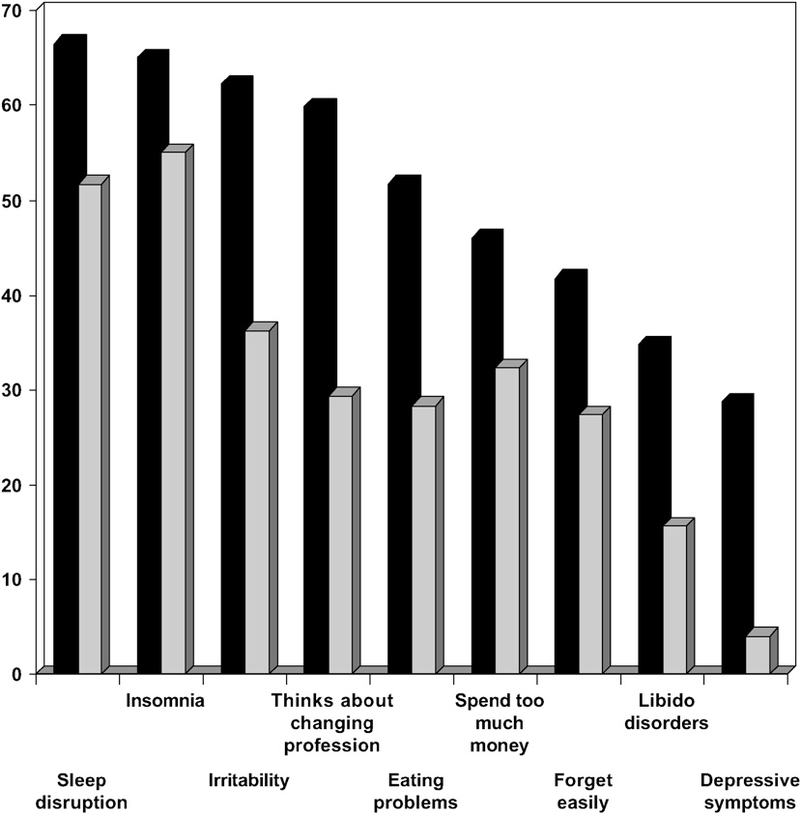
Burn Out Syndrome

Slide 44
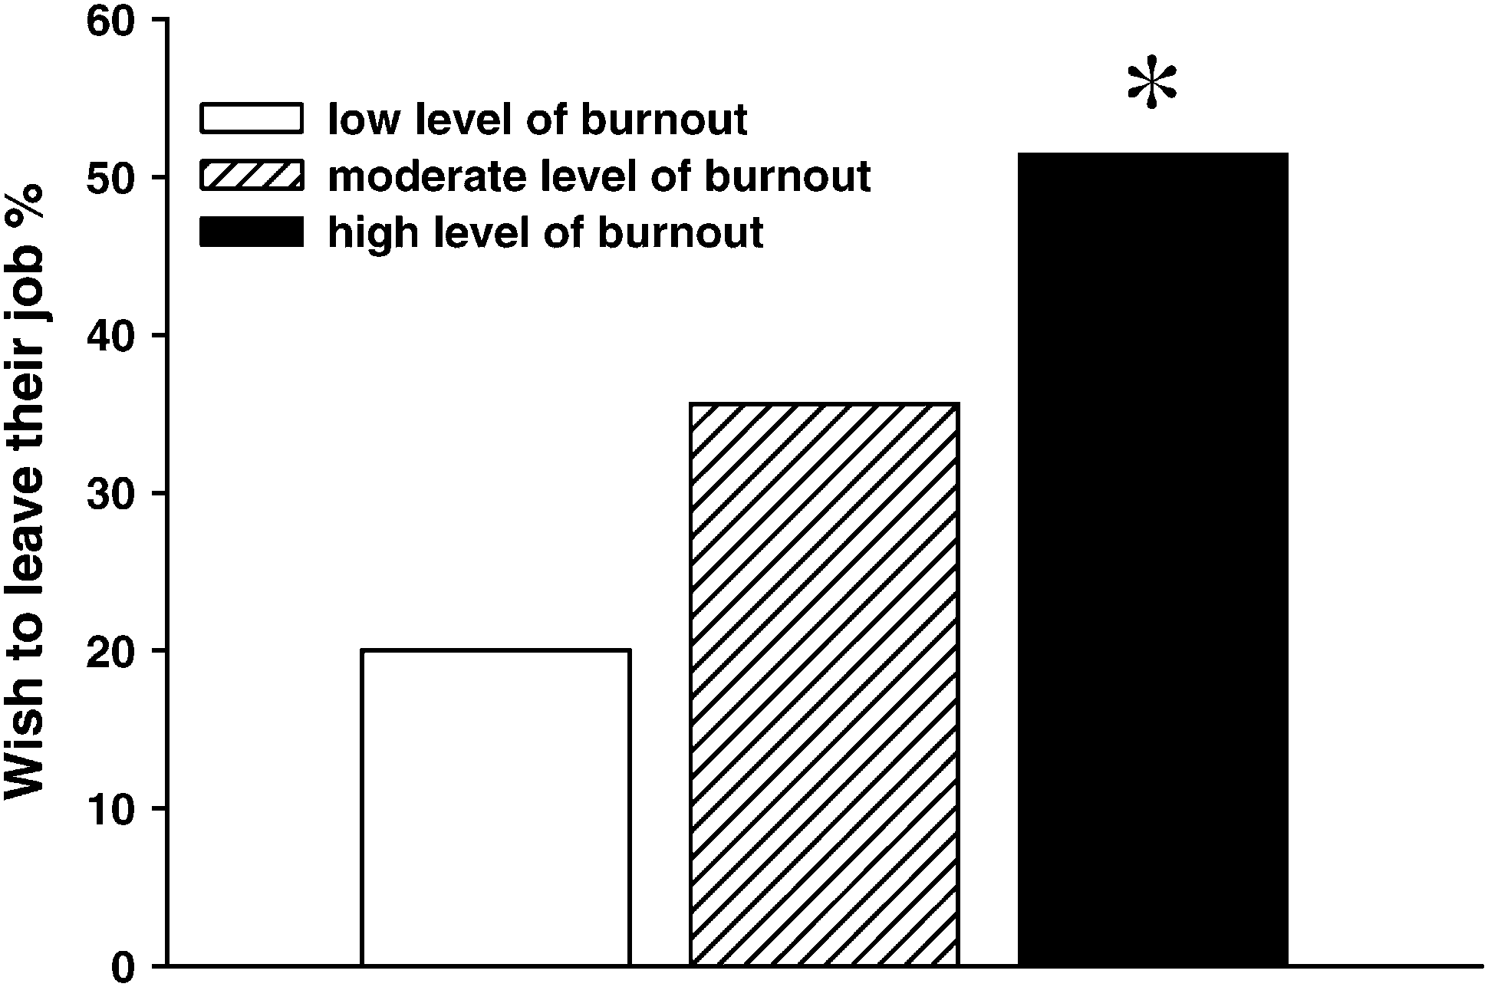
Burn Out Syndrome

Slide 45
Monday, October 11, 2010 NY Times
For several decades now, studies have consistently shown that physicians have higher rates of suicide than the general population — 40 percent higher for male doctors and a staggering 130 percent higher for female doctors.
Students enter medical school with mental health profiles similar to those of their peers but end up experiencing depression, burnout and other mental illnesses at higher rates.

Slide 46
Every birth can survive for 90 years
Scandavian Countries

Slide 47
Swiss Age

Slide 48
Health
Hippocrates, stated something similar over 2,000 years ago - in the 5th century BC:
"Positive health requires knowledge of man's primary constitution and the powers of various foods, both those natural to them and those resulting from human skills. But eating alone is not enough for health. There must be exercise, of which the effects must likewise be known. The combination of these two things makes regimen, when proper attention is given to the seasons of the year, the changes of the winds, the age of the individual and the situation of his home".

Slide 49
Disease: Any deviation from or interruption of the normal structure or function of any body part, organ, or system that is manifested by a characteristic set of symptoms and signs and whose etiology, pathology, and prognosis may be known or unknown. Health: Health is a state of complete physical, mental and social well-being and not merely the absence of disease or infirmity. (1948 WHO) An expansion of the WHO definition may be necessary to include a spiritual dimension of health if social scientists can agree that spirituality is part of health and not merely an influence. James S Larson. The World Health Organization's definition of health: Social versus spiritual health . 1996 Social Indicators Research. Volume 38, Number 2. 181-192,

Slide 50
Definitions
an integral aspect of religious experience;
recognize aspects of life and human experience which are not captured by a purely materialist or mechanistic view of the world;
"spiritual" as nurturing thoughts, emotions, words and actions that are in harmony with a belief that the entire universe is, in some way, connected;
spirituality as the active connection to some force/power/energy/spirit, facilitating a sense of a deep self;

Slide 51
What is spirituality?
Spirituality, in a wide variety of cultural and religious concepts, is itself often seen as incorporating a spiritual path, along which one advances to achieve a given objective, such as a higher state of awareness, to become perfect human being, outreach wisdom or communion with God or with creation.

Slide 52
Spiritual disciplines
meditation, prayer, fasting
process in two phases:
first on inner growth,
the second on the manifestation of this result daily in the world.
"Religion is not identical with spirituality; rather religion is the form spirituality takes in civilization."
yogi William Irwin Thompson
"Where religion ends, spirituality begins“
-Babuji Maharaj

Slide 53
What you want? Bliss or Misery; Atma conscious or Body conscious.
It is your choice.

Slide 54
Thank you

